Slide 1
Data Science in R Language
Shantanu Bindewari June 20, 2022
Teaching Associate,CSE
SIT Pune

Slide 2
Outlines
Why Data Science?
Why R?
R installation
AI vs ML vs DL vs DS
Data Acquisition
Data Preparation
Data Analysis
Introduction to R

Slide 4
Why Use R?
It is a great resource for data analysis, data visualization, data science and machine learning
It provides many statistical techniques (such as statistical tests, classification, clustering and data reduction)
It is easy to draw graphs in R, like pie charts, histograms, box plot, scatter plot, etc++
It works on different platforms (Windows, Mac, Linux)
It is open-source and free
It has a large community support
It has many packages (libraries of functions) that can be used to solve different problems

Slide 5
Introduction
It was designed by Ross Ihaka and Robert Gentleman at the University of Auckland, New Zealand in 1993, and is currently developed by the R Development Core Team. R programming language is an implementation of the S programming language.
Features of R Programming Language
Basic Statistics
Static graphics
Probability distributions
Data analysis
R Packages: 10, 0000 packages
Distributed Computing

Slide 6
Area
Data Miners
Bioinformaticians
Statisticians
Developing Statistical Software

Slide 7
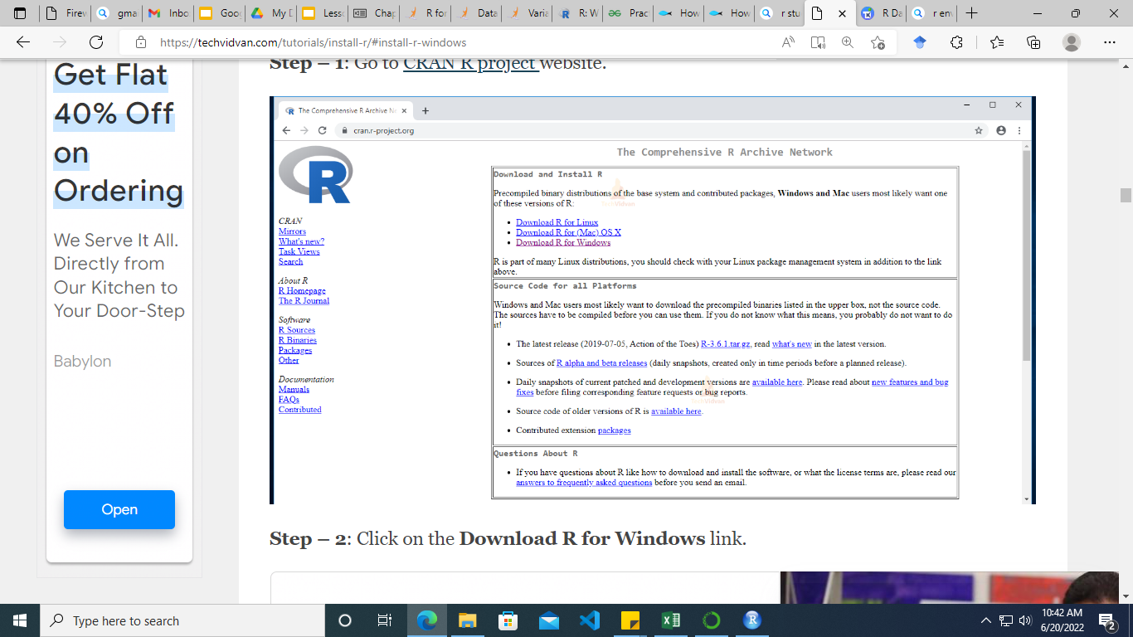
Installation
Install R and
RStudio on windows
Install R on windows
Go to CRAN R project .

Slide 8
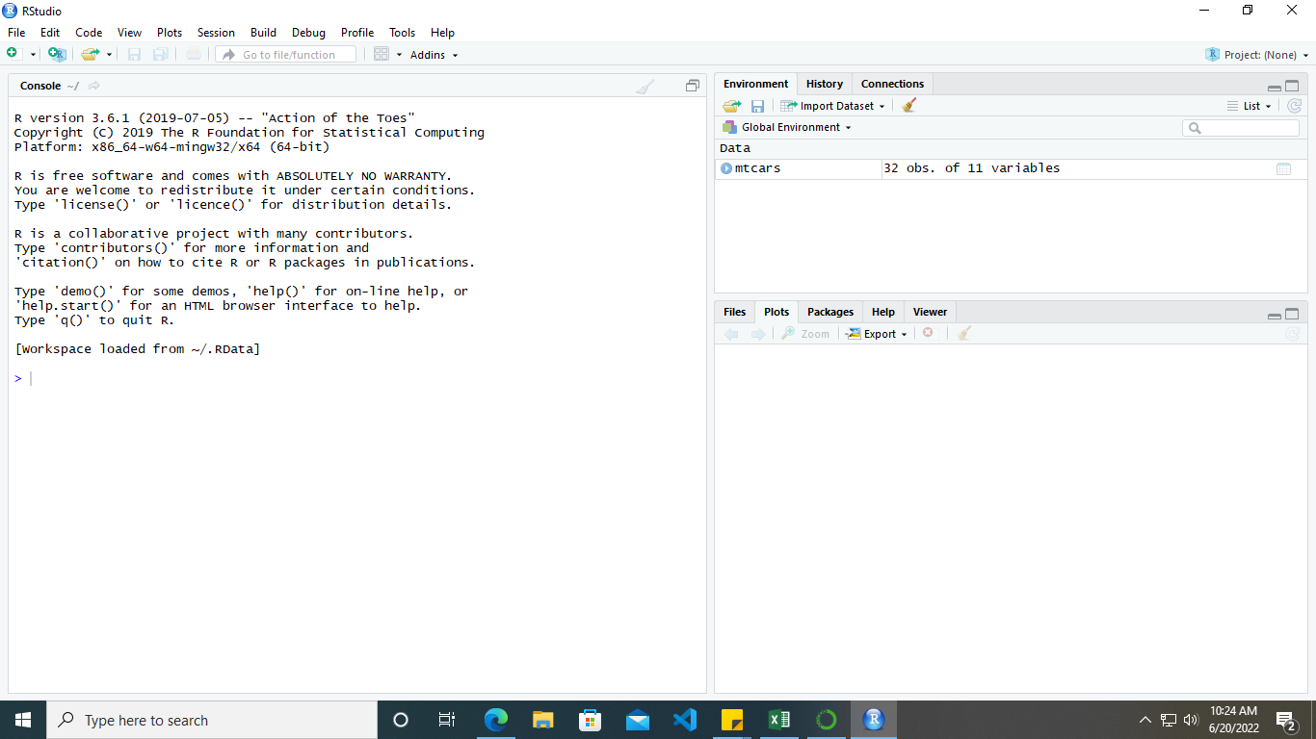
R User Interface

Slide 9
Data Types
Atomic Vectors of R Atomic Data Type
Data Type | Example | Description
Logical | TRUE, FALSE | boolean values
Numeric | 2, 45.9, 3782 | Numbers of all kinds
Integer | 9L, 779L | Explicitly Integers
Complex | 8+9i | Real Value + Complex Value
Character | ‘m’, “hello” | Characters and Strings
Raw | [68, 65, 6C, 6C,6F] is the value for string hello. | Any data is stored as raw bytes

Slide 10
We shall run the following commands to assign variables, data of different data types and print the class of the variable to verify the data type.
Logical
Numeric
> x <- TRUE > print(class(x)) [1] "logical"
> x <- 67.54 > print(class(x)) [1] "numeric"

Slide 11
Integer
Character
Raw
x <- 63L > print(class(x)) [1] "integer"
> x <- "hello" > print(class(x)) [1] "character"
Complex
> x <- 6 + 4i > print(class(x)) [1] "complex"
> x <- charToRaw("hello") > print(class(x)) [1] "raw"

Slide 12
Data Types of R – Objects
As already mentioned there are many types of R Objects. We shall look into some of the most commonly used data types. They are :
Vectors
Lists
Matrices
Arrays
Factors
Data Frames

Slide 13
> fruits = c('apple','orange',"banana") > print(class(fruits))
[1] "character"
> print(fruits)
[1] "apple" "orange" "banana"
Syntax – Define a Vector
R Vector
variable <- c(comma separated atomic vectors belonging to a data type)
Following is an example of a Character Vector.

Slide 14
R Lists
Syntax to Define List
In R programming language, a List is a collection of List Items (R Objects) belonging to different data types. A List may contain another list as its item. A List Item may contain a Matrices, an Array, a Factor, an R function or any of R Object.
variable <- list(comma seperated list items)
Following is an example of an R List.

Slide 15
> listX = list(51,"hello",tan,list(8L,"a")) > print(listX)
[[1]]
[1] 51
[[2]]
[1] "hello"
[[3]]
function (x) .Primitive("tan")
[[4]]
[[4]][[1]]
[1] 8
[[4]][[2]]
[1] "a"

Slide 16
split by row or column : if TRUE then its split by row, else if its FALSE then split by column.
Following is an example to define a matrix :
1. Split by row.
Syntax – Define Matrix
In R programming language, A Matrix is a 2-D set of data elements. A Vector, number of rows and number of columns could be used to create a Matrix.
variable <- matrix(vector, number of rows, number of columns, split by row or column)
> A = matrix(c(1,2,3,4,5,6,7,8),2,4,TRUE) > print(A)
[,1] [,2] [,3] [,4]
[1,] 1 2 3 4
[2,] 5 6 7 8

Slide 17
2. Split by column.
> A <- matrix(c(1,2,3,4,5,6,7,8),2,4,FALSE) > print(A) [,1] [,2] [,3] [,4] [1,] 1 3 5 7 [2,] 2 4 6 8

Slide 18
R Arrays
Syntax – Define an R Array
In R programming language, Arrays are N-Dimensional data sets.
variable <- array(list, dimension)
where list contains the elements of array and dimension is a list containing the information about dimensionality of the array. If dimension is c(2,5,4,8), the array is 4-Dimensional with dimensions 2x5x4x8.
Following is an example of 3-D array.

Slide 19
> A = array(c(1,2,3,4,5,6,7,8,9,10,11,12),c(2,3,2)) > print(A)
, , 1
[,1] [,2] [,3]
[1,] 1 3 5
[2,] 2 4 6
, , 2
[,1] [,2] [,3]
[1,] 7 9 11
[2,] 8 10 12

Slide 20
R Factors
In R programming language, a Factor is a vector along with the distinct values of vector as levels. Factors are useful during statistical modelling.
Levels are stored as R Characters.
Following is an example to define an R Factor
> factorX = factor(c(1,4,7,2,6,7,1,6,4)) > print(factorX)
[1] 1 4 7 2 6 7 1 6 4
Levels: 1 2 4 6 7

Slide 21
R Data Frames
Syntax – Define an R Data Frame
In R programming language, a Data Frame is a set of equal length vectors. The vectors could be of different data types.
variable <- data.frame(listA, listB, listC, .., listN)
Following is an example to define an R Data Frame :
> dataX = data.frame(values = c(21,42,113), RGB = c('red','blue','green')) > print(dataX)
values RGB
1 21 red
2 42 blue
3 113 green

Slide 22
R Variables
In this tutorial, we shall learn about R Variables, how to assign value to a variable, know the data type of variable, find the list of variables and delete some of them if required.
Rules for writing R Variables
Following are the rules to give a valid name to an R variable.
It may contain letters (Examples : x, y, varx, .. )
It may contain numbers (Examples : x1, y1, var25x, .. )
It may contain special char Dot (.) (Examples : x., y., var.x, .. )
It may contain special char Underscore(_) (Examples : x_1, y_2, var_x, .. )
The first character in the name could be a letter. (Examples : x, y, varx, .. )
The first character in the name could be a dot not followed by a number. (Examples : .x, .y, varx, .. )
Reserved words in R could not be used for variables.
Examples for invalid variable names : .2x, tan, er@t

Slide 23
Assign value to R Variable
R Variable can be assigned a value using one of the following three operators :
Equal Operator =
Leftward Operator <-
Rightward Operator ->

Slide 24
> x = 'hello' > print(x) [1] "hello" > x <- 'learn r' > print(x) [1] "learn r" > 'r programming language' -> x > print(x) [1] "r programming language"
In the following, we have examples for equal operator, leftward operator and rightward operator respectively.

Slide 25
To find all R variables that are alive at a point in R command prompt or R script file, ls() is the command that returns a Character Vector.
> ls()
[1] "a" "A" "dataX"
[4] "factorX" "fruits" "listX"
[7] "RGB" "r programming language" "v"
[10] "values" "x" "y"
> p = 36.89
> ls()
[1] "a" "A" "dataX"
[4] "factorX" "fruits" "listX"
[7] "p" "RGB" "r programming language"
[10] "v" "values" "x"
[13] "y"

Slide 26
Delete an R Variable
rm(variable_name) deletes an R variable from the stack of variables in a running instance.
> ls()
[1] "a" "A" "dataX"
[4] "factorX" "fruits" "listX"
[7] "p" "RGB" "r programming language"
[10] "v" "values" "x"
[13] "y"
> rm(fruits)
> ls()
[1] "a" "A" "dataX"
[4] "factorX" "listX" "p"
[7] "RGB" "r programming language" "v"
[10] "values" "x" "y"

Slide 27
R Operators
Arithmetic, Relational, Logical, Assignment and some of the Miscellaneous Operators that R programming language provides.
Arithmetic Operators | + | - | * | %% | ^
Relational Operators | < | > | == | >=/<= | !=
Logical Operators | & | | | ! | && | ||
Assignment Operators | = | <- | -> | <<- | ->>
Misc. Operators | : | %in% | %*%

Slide 28
Operator | Description | Usage
+ | Addition of two operands | a + b
– | Subtraction of second operand from first | a – b
* | Multiplication of two operands | a * b
/ | Division of first operand with second | a / b
%% | Remainder from division of first operand with second | a %% b
%/% | Quotient from division of first operand with second | a %/% b
^ | First operand raised to the power of second operand | a^b

Slide 29
An example for each of the arithmetic operator on Numerical values is provided below.
a <- 7.5
b <- 2
print ( a+b ) #addition
print ( a-b ) #subtraction
print ( a*b ) #multiplication
print ( a/b ) #Division
print ( a%%b ) #Reminder
print ( a%/%b ) #Quotient
print ( a^b ) #Power of
Output
$ Rscript r_op_arithmetic.R [1] 9.5 [1] 5.5 [1] 15 [1] 3.75 [1] 1.5 [1] 3 [1] 56.25

Slide 30
An example for each of the arithmetic operator on Vectors is provided below.
# R Operators - R Arithmetic Operators Example for vectors
a <- c(8, 9, 6)
b <- c(2, 4, 5)
print ( a+b ) #addition
print ( a-b ) #subtraction
print ( a*b ) #multiplication
print ( a/b ) #Division
print ( a%%b ) #Reminder
print ( a%/%b ) #Quotient
print ( a^b ) #Power of
Output
$ Rscript r_op_arithmetic_vector.R [1] 10 13 11 [1] 6 5 1 [1] 16 36 30 [1] 4.00 2.25 1.20 [1] 0 1 1 [1] 4 2 1 [1] 64 6561 7776

Slide 31
Following are the six relational operations R programming language supports.The output is boolean (TRUE or FALSE)
Operator | Description | Usage
< | Is first operand less than second operand | a < b
> | Is first operand greater than second operand | a > b
== | Is first operand equal to second operand | a == b
<= | Is first operand less than or equal to second operand | a <= b
>= | Is first operand greater than or equal to second operand | a > = b
!= | Is first operand not equal to second operand | a!=b

Slide 32
An example for each of the relational operator on Numberical values is provided below.
# R Operators - R Relational Operators Example for Numbers
a <- 7.5
b <- 2
print ( ab ) # greater than
print ( a==b ) # equal to
print ( a<=b ) # less than or equal to
print ( a>=b ) # greater than or equal to
print ( a!=b ) # not equal to
Output
$ Rscript r_op_relational.R [1] FALSE [1] TRUE [1] FALSE [1] FALSE [1] TRUE [1] TRUE

Slide 33
An example for each of the relational operator on Vectors is provided below.
# R Operators - R Relational Operators Example for Numbers
a <- c(7.5, 3, 5)
b <- c(2, 7, 0)
print ( a<b ) # less than
print ( a>b ) # greater than
print ( a==b ) # equal to
print ( a<=b ) # less than or equal to
print ( a>=b ) # greater than or equal to
print ( a!=b ) # not equal to
Output
$ Rscript r_op_relational_vector.R [1] FALSE TRUE FALSE [1] TRUE FALSE TRUE [1] FALSE FALSE FALSE [1] FALSE TRUE FALSE [1] TRUE FALSE TRUE [1] TRUE TRUE TRUE

Slide 34
R Logical Operators
Logical Operators in R programming language work only for the basic data types logical, numeric and complex and vectors of these basic data types.
Operator | Description | Usage
& | Element wise logical AND operation. | a & b
| | Element wise logical OR operation. | a | b
! | Element wise logical NOT operation. | !a
&& | Operand wise logical AND operation. | a && b
|| | Operand wise logical OR operation. | a || b

Slide 35
An example for each of the logical operators on Numerical values is provided below.
# R Operators - R Logical Operators Example for basic logical elements
a <- 0 # logical FALSE
b <- 2 # logical TRUE
print ( a & b ) # logical AND element wise
print ( a | b ) # logical OR element wise
print ( !a ) # logical NOT element wise
print ( a && b ) # logical AND consolidated for all elements
print ( a || b ) # logical OR consolidated for all elements
Output
$ Rscript r_op_logical.R [1] FALSE [1] TRUE [1] TRUE [1] FALSE [1] TRUE

Slide 36
An example for each of the logical operators on Vectors is provided below.
# R Operators - R Logical Operators Example for boolean vectors
a <- c(TRUE, TRUE, FALSE, FALSE)
b <- c(TRUE, FALSE, TRUE, FALSE)
print ( a & b ) # logical AND element wise
print ( a | b ) # logical OR element wise
print ( !a ) # logical NOT element wise
print ( a && b ) # logical AND consolidated for all elements
print ( a || b ) # logical OR consolidated for all elements
Output
$ Rscript r_op_logical_vector.R [1] TRUE FALSE FALSE FALSE [1] TRUE TRUE TRUE FALSE [1] FALSE FALSE TRUE TRUE [1] TRUE [1] TRUE

Slide 37
R Assignment Operators
Assignment Operators are those that help in assigning a value to the variable.
Operator | Description | Usage
= | Assigns right side value to left side operand | a = 3
<- | Assigns right side value to left side operand | a <- 5
-> | Assigns left side value to right side operand | 4 -> a
<<- | Assigns right side value to left side operand | a <<- 3.4
->> | Assigns left side value to right side operand | c(1,2) ->> a

Slide 38
An example for each of the assignment operators is provided below.
# R Operators - R Assignment Operators
a = 2
print ( a )
a <- TRUE
print ( a )
454 -> a
print ( a )
a <<- 2.9
print ( a )
c(6, 8, 9) -> a
print ( a )
Output
[1] 2
[1] TRUE
[1] 454
[1] 2.9
[1] 6 8 9

Slide 39
R Miscellaneous Operators
Operator | Description | Usage
: | Creates series of numbers from left operand to right operand | a:b
%in% | Identifies if an element(a) belongs to a vector(b) | a %in% b
%*% | Performs multiplication of a vector with its transpose | A %*% t(A)

Slide 40
R Decision Making
In R programming, Decision Making statements help to decide whether to execute a block of code or not, based on a condition. Decision making is an important aspect in any programming language. Decision Making statements are also called Conditional statement.
R If statement executes a set of statements based on a given condition. If the condition in If-statement evaluates to TRUE, then the statements in the If block execute, else not.
In this tutorial, we will learn about R If statement and how does this help in decision making with syntax, flow diagram and examples.

Slide 41
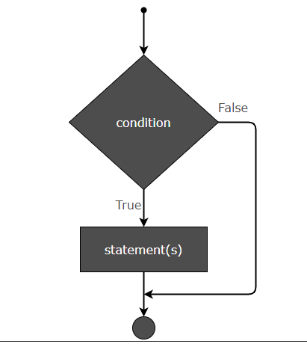
Flow Diagram
The flow diagram that shows the flow of execution for an if statement is given below.

Slide 42
Syntax
The syntax of R If statement is
if (condition) {
statement1
statement2 . . .
Statement N
}

Slide 43
Example.R
a <- 6 if (a == 6) { print ("Value in a is 6.") } print("End of program.")
Output
[1] "Value in a is 6." [1] "End of program."

Slide 44
Check if Number is Even using If
In this example, we use If-statement to check if a number is even. If n is the number, then If-condition could be n%%2 == 0.
Example.R
n <- 10 if (n %% 2 == 0) { print ("Number is even.") }
Output
[1] "Number is even and divisible by 3."

Slide 45
Using AND Operator in IF Condition
In this example, we check if given number is even and divisible by 3. Since the number has to satisfy both the conditions, we may join the condition using AND operator.
Example.R
n <- 12 if ((n %% 2 == 0) && (n %% 3 == 0)) { print ("Number is even and divisible by 3.") }
Output
[1] "Number is even and divisible by 3."

Slide 46
Example.R
n <- 11 if (!(n %% 2 == 0)) { print ("Number is not even.") }
Output
[1] "Number is not even."

Slide 47
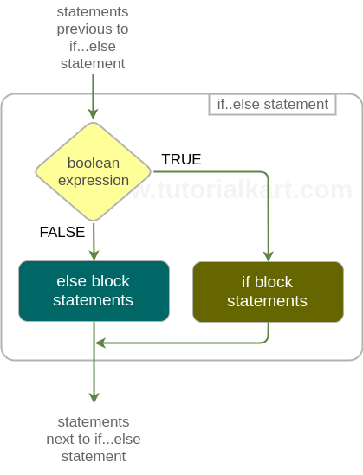
Syntax – R if-else
The syntax of R if else statement is
if(boolean_expression){ if_block_statements } else { else_block_statements }

Slide 48
Example of IF_ELSE
# R if..else statement Example
# for TRUE condition
a = 6
if(a==6){
print ("Condition a==6 is TRUE")
print ("This is second statement in if block")
} else{
print ("Condition a==6 is FALSE")
print ("This is second statement in else block")
}
# for FALSE condition
b = 7
if(b==6){
print ("Condition b==6 is TRUE")
print ("This is second statement in if block")
} else{
print ("Condition b==6 is FALSE")
print ("This is second statement in else block")
}
Output
$ Rscript r_if_else_example.R [1] "Condition a==6 is TRUE" [1] "This is second statement in if block" [1] "Condition b==6 is FALSE" [1] "This is second statement in else block"

Slide 49
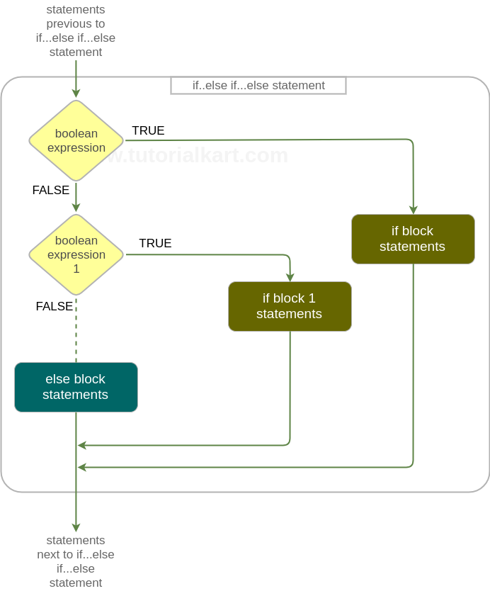
R if else if
if the condition provided to the if statement is true, then the statements in the if statement block are executed, else another R if…else statement is evaluated. You may append as many number of if…else statement one to each other.
Following is a flow diagram depicting the flow of execution around and in an if..else if…else statement.

Slide 50
Syntax – If – Else If
The syntax of if-else-if statement is
if(boolean_expression){
if_block_statements
} else if(boolean_expression_1) {
if_block_1_statements
} else if(boolean_expression_1) {
if_block_2_statements
}
.
.
else {
else_block_statements
}

Slide 51
Example 1 – R If Else If
b = 7
if(b==6){
print ("Condition b==6 is TRUE")
} else if(b==7){
print ("Condition b==7 is TRUE")
} else if(b==8){
print ("Condition b==8 is TRUE")
} else{
print ("No if condition is TRUE for b")
}
Output
$ Rscript r_if_else_if_else_example.R [1] "Condition b==7 is TRUE"

Slide 52
R Switch
R switch statement selects one of the cases, based on the value of an expression.
There are two ways in which one of the cases is selected: based on index or matching value.
Switch based on Index – If the cases are just values and the expression evaluates to a number, then the expression’s value is used as index to select the case.
Switch based on Matching Value – If cases have both case value and output value like case_1=value1, then the expression value is matched against cases. When there is a match with a case, the corresponding value is the output.
Switch based on Index
The syntax of Switch statement which selects one of the cases based on index is
switch(expression, value1, value2, value3, ...)

Slide 53
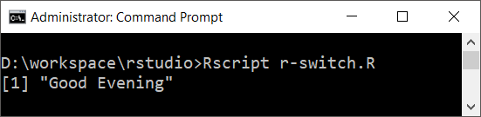
Example 1
In this example, we will use switch statement based on index. The value of y, is taken as index.
y <- 3
x <- switch(
y,
"Good Morning",
"Good Afternoon",
"Good Evening",
"Good Night"
)
print(x)
Output

Slide 54
Switch based on Matching Value
The syntax of switch statement based on matching value is
switch(expression, case1=value1, case2=value2, ..., caseN=valueN)

Slide 55
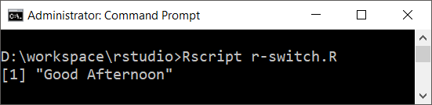
Example 1
In this example, we will write a switch statement that selects on of the many values by matching expression’s value with the cases.
y <- "12"
x <- switch(
y,
"9"="Good Morning",
"12"="Good Afternoon",
"18"="Good Evening",
"21"="Good Night"
)
print(x)
Output

Slide 56
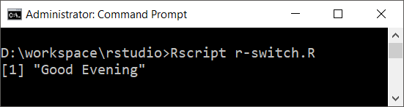
Example 2
In the following R switch statement, we used a string concatenation expression.
a <- "1" b <- "8" x <- switch( paste(a,b,sep=""), "9"="Good Morning", "12"="Good Afternoon", "18"="Good Evening", "21"="Good Night" ) print(x)
Output

Slide 57
R Programming
Data Exploration
Data Abstraction
Data Manipulation

Slide 58
Data Exploration

Slide 59
Command
datasets::mtcars # We can import inbuilt datasets from the R networt
install.packages(mtcars) #install the mtcars dataset
library(mtcars) #using mtcars dataset
View(mtcars) #view the mtcars data set variables
head(mtcars) # View the top 5 data set of the mtcars dataset
str(mtcars) # view the structure of the dataset
summary(mtcars) # View the summary of the dataset (mean, quart. Range i.e
row.names(mtcars) #View the row count of the dataset
colnames(mtcars) #View the coulmns count of the dataset

Slide 60
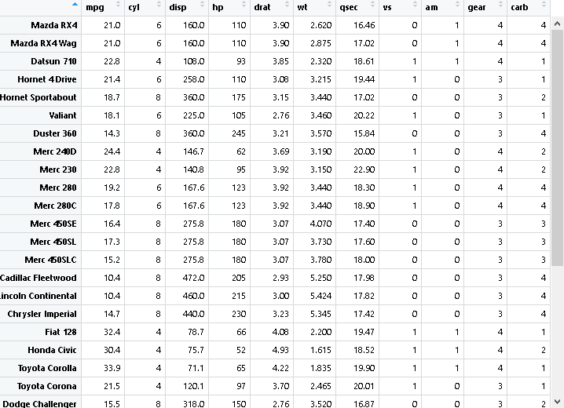

Slide 61
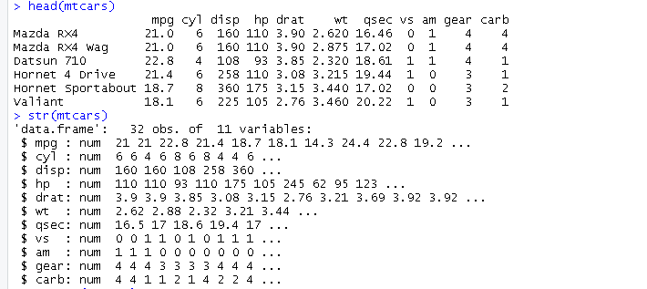

Slide 62
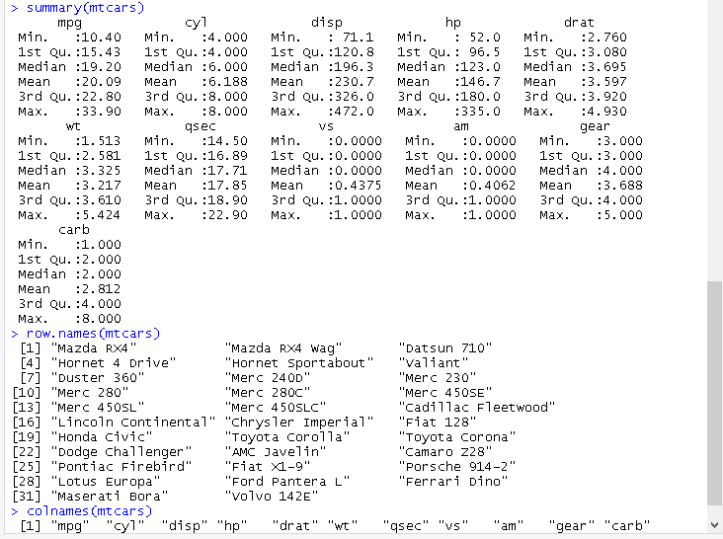

Slide 63
Data Manipulation

Slide 64
Is.na(mtcars) # #find the null values in mtcar dataset
new<-na.omit(na.omit(mtcars)) # remove the nullvalues from the dataset
Complete.cases(mtcars) # all cases view in this method
Table(complete.cases(mtcars)) #only tables cases view in this

Slide 65
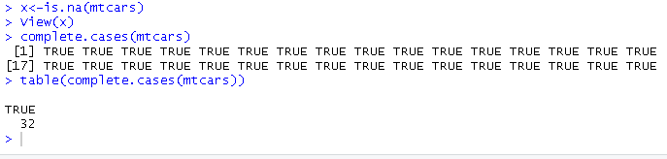

Slide 66
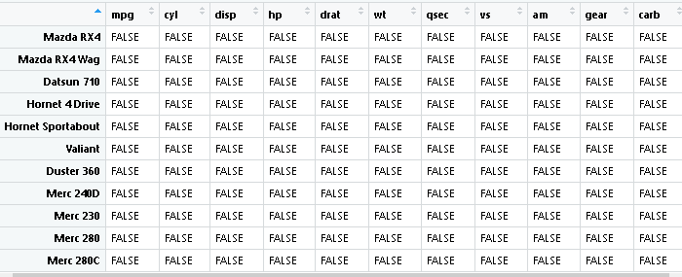

Slide 67

cor(mtcars$mpg,mtcars$disp)
# find the relation between two and more variable so (~) between them
# By $ symbol you can call the variable of dataset

Slide 68
Data Reshaping through melting and casting
datasets::iris
install.packages(iris)
head(iris)
# data reshapping through melting and casting
install.packages("reshape2")
library(reshape2)
molten.iris<-melt(iris,id=c("Species"))
View(molten.iris)
cast.iris<-dcast(molten.iris,Species~variable,sum)
View(cast.iris)

Slide 69
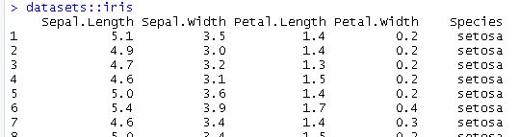
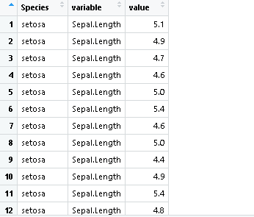
Melt()

Slide 70

dcast()

Slide 71
dplyr()
Install.packages(“dplyr”) # data manipulation for huge data
Library(dplyr)

Slide 72
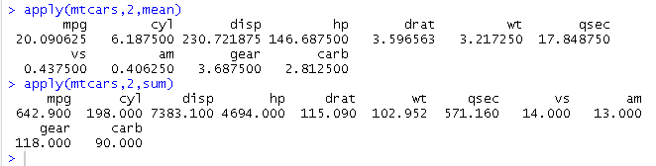
apply()
apply(mtcars,2,mean)
apply(mtcars,2,sum)

Slide 73
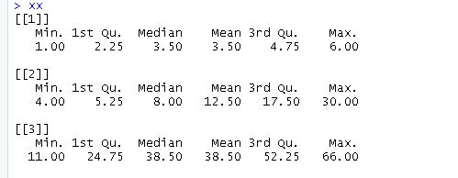
Summary using apply()
#for list summary
subject1<-c(1,2,3,4,5,6)
subject2<-c(10,20,30,4,5,6)
subject3<-c(11,22,33,44,55,66)
list1<-list(subject1,subject2,subject3)
xx<-lapply(list1, summary)#list
xx

Slide 74
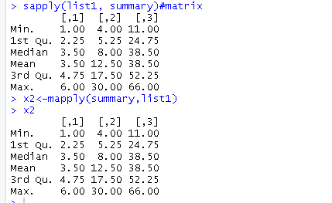
sapply(list1, summary)#matrix
x2<-mapply(summary,list1)
x2

Slide 75

Find the dimension of the dataset
dim(mtcars)
dim(iris)

Slide 76
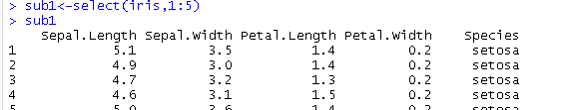
Select()
#select function
names(iris)[1:5] #colon: operator use to select the range of the column
sub1<-select(iris,1:5)
View(sub1)

Slide 77
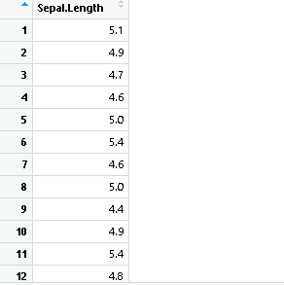
Esub<-select(iris,-(2:5))
# using (-) negative sign it will be showing except these coulms will show.
View(Esub)

Slide 78
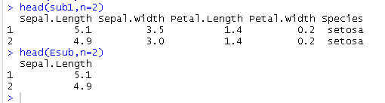
head(sub1,n=2)
head(Esub,n=2)

Slide 79
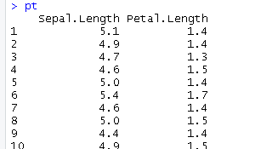
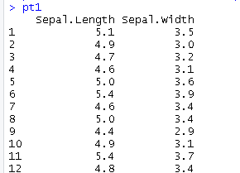
pt<-select(iris,ends_with("Length"))
#select specific fields
Pt
pt1<-select(iris,starts_with("sepal"))
Pt1

Slide 80
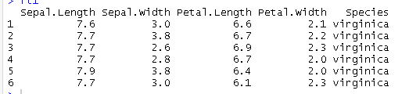
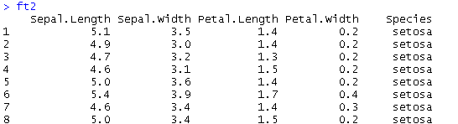
Filter()
ft1<-filter(iris,Sepal.Length>7.5)
Ft1
ft2<-filter(iris,Sepal.Length>7.5
| Petal.Width<2.0)
# filter with logical operation
ft2

Slide 81
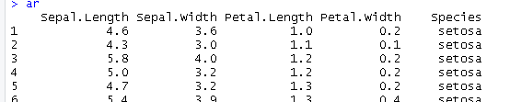
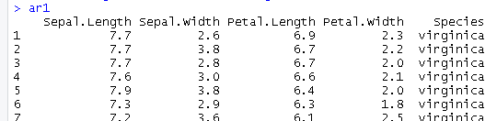

Arrange()
#arrange()
ar<-arrange(iris,Petal.Length)# Arrange specified columns in ascending order
ar
tail(ar,n=2) # find new records in data set
ar1<-arrange(iris,desc(Petal.Length))
ar1

Slide 82

Rename()
#rename() change the name of the column
rn<-rename(iris,SL=Sepal.Length,SW=Sepal.Width)
rn

Slide 83
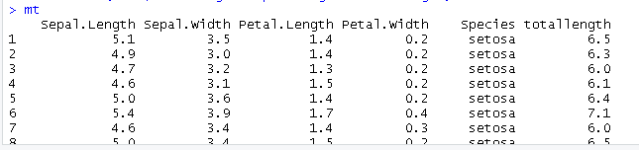
Mutate()
mt<-mutate(iris,totallength=Sepal.Length+Petal.Length)
#add new column using existing column data
mt

Slide 84
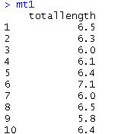
Transmute()
#transmute() display new column only
mt1<-transmute(iris,totallength=Sepal.Length+Petal.Length)
mt1

Slide 85
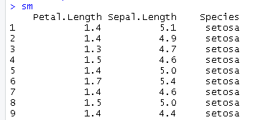


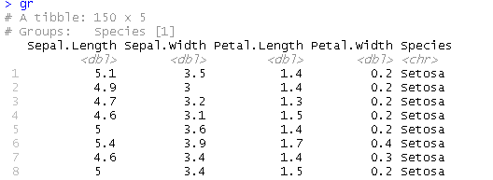
#sample() this is used to select random rows from the data set
sm<-sample(iris,size =3) #rows
sm
sm1<-sample(iris,size =0.03) #percentage of rows
sm1
#count() count based on groups
cn<-count(iris,Species)
cn
#group_by
gr<-group_by(iris,Species='Setosa')
gr
gr1<-group_by(iris,Species!='virginica')
gr1
smr<-summarise(gr,mean(Sepal.Length))
smr

Slide 86
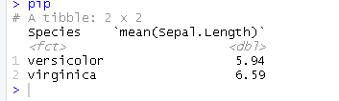
Piping %>% for joining multiple operation together
pip<-iris %>% filter(Species!='setosa') %>% group_by(Species) %>% summarise(mean(Sepal.Length))
pip

Slide 87
Data Visualization

Slide 88
Visualization
Barplot
histogram
Pie chart
Boxplot
Scatter Plot
Line Graph
Heatmap

Slide 89
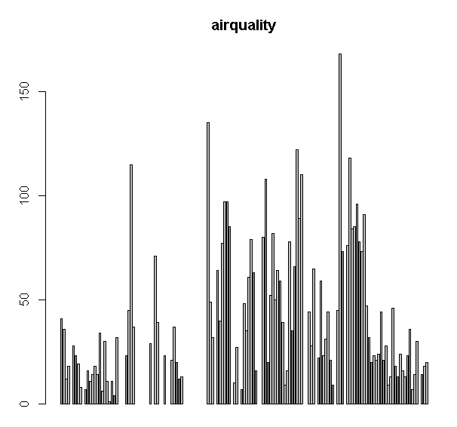
Barplot
datasets::airquality
install.packages("airquality")
library(airquality)
barplot(airquality$Ozone,main = "airquality",
horiz =F,xlab = "ozone")

Slide 90
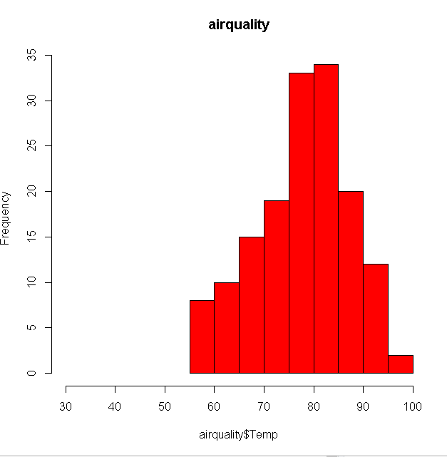
Histogram
hist(airquality$Temp,main = "airquality",
horiz=F,col = "red",freq = T,xlim
= c(30,100))

Slide 91
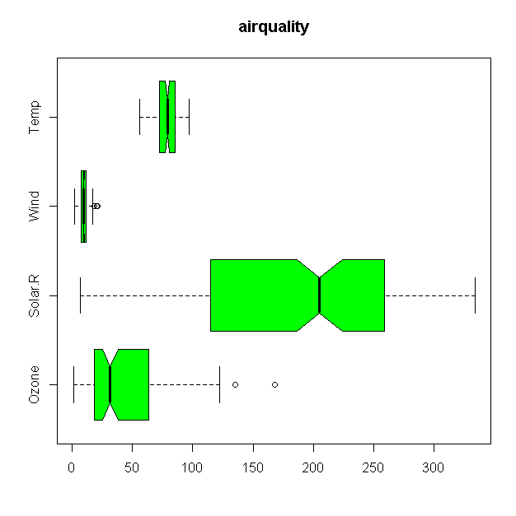
boxplot(airquality[,0:4],main="airquality",
col = "green",horizontal = T,notch = T)

Slide 92
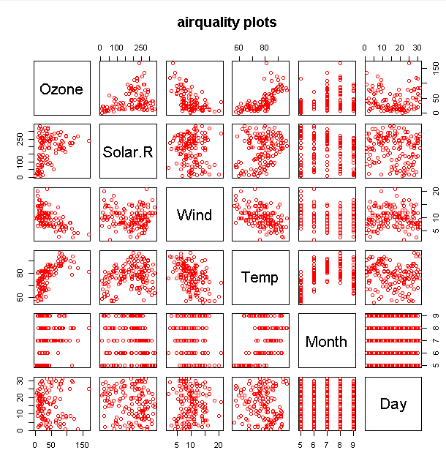
plot
plot(airquality,col="red",main =
"airquality plots")

Slide 93
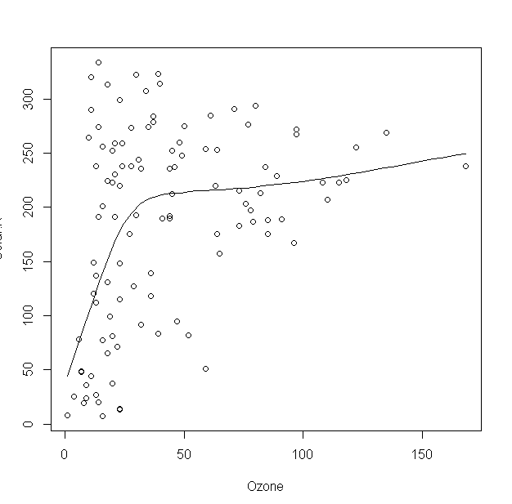
scatterplot
scatter.smooth(airquality)

Slide 94
piechart
Accenture<-c(2,7,8,3,10,11)
Microsoft<-c(15,10,6,21,23,9)
TCS<-c(8,19,10,15,14,21)
INFOSYS<-c(15,23,21,28,11,30)
TURNOVER<-c(100,120,130,200)
companies<-c("Accenture","Microsoft“
,"TCS","INFOSYS")
pie(TURNOVER,companies,main="turn over")

